Slide 1
Paf-kiet High voltage III-phase inverter
Group members: Masood ahmed Rafay (5995)
Mohammad daniyal badar (6030)
Junaid Akhter (6087)
Internal advisor: lect. nouman masood
Sponsored by: Star engineering
S e n I o r d e s I g n p r o j e c t

Slide 2
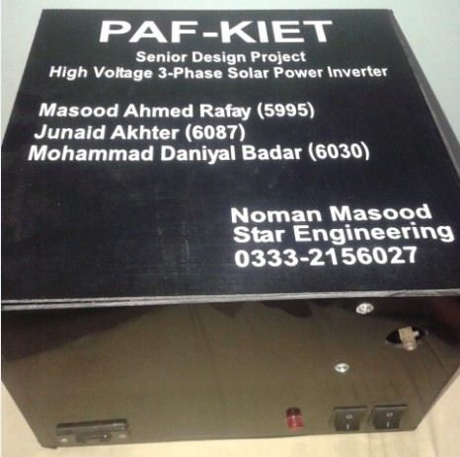
introduction

Slide 3

Problem discussion
Increasing Demand of Electric Power
Load-shedding
Maintenance Problems

Slide 4

Aims and objectives
Constant AC-Supply
Drives Moderate Power Loads
Providing Cheap Electric Power
Environment Friendly Setup
Less Risk of Breakdown

Slide 5

functionality
Conserve Electricity
Can be installed anywhere
Drive Three Phase motors

Slide 6
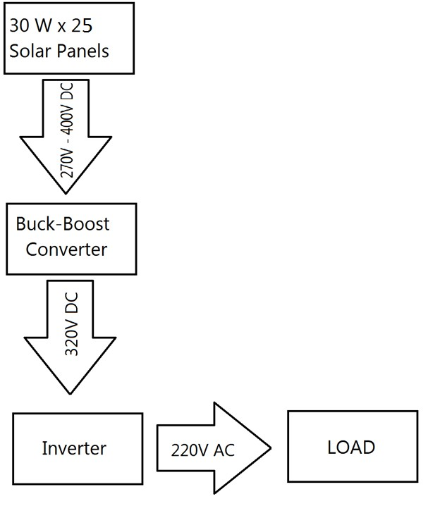
Block Diagram

Slide 7
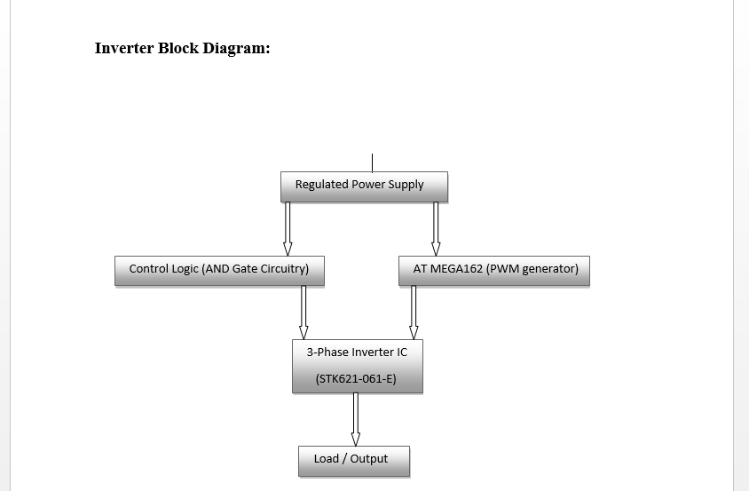
Sub block diagram

Slide 8
Internal equivalent circuit diagram of stk-621061

Slide 9
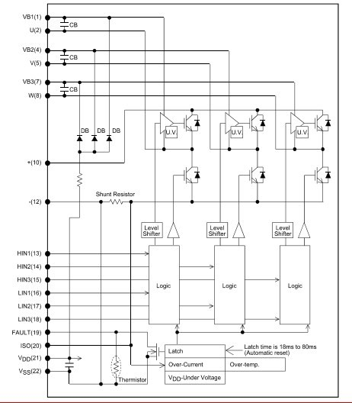

Slide 10
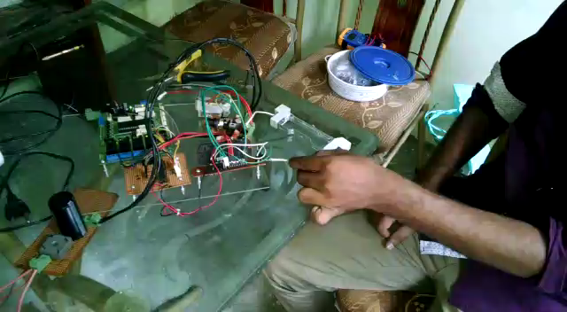
Video of 3 Phase Output

Slide 11


Slide 12

Safety and precautions
Rubber Gloves
Safety Goggles
Testing Environment
Heat Sink
Discharging Capacitor

Slide 13

conclusion
Modified Sine-Wave as output
Drives Resistive load perfectly
Drive Inductive load but there is a 20% drop in efficiency due to harmonics.

